Slide 1
Introducing R-Ladies Newcastle

Slide 2
Representation of women in the R community
9% of package owners are women (self-reported) (Mair et al., 2015)
2016 useR conference: 28% of attendees were women (https://forwards.github.io/data/)
R-Ladies is a global organisation whose mission is to promote gender diversity in the R community

Slide 3
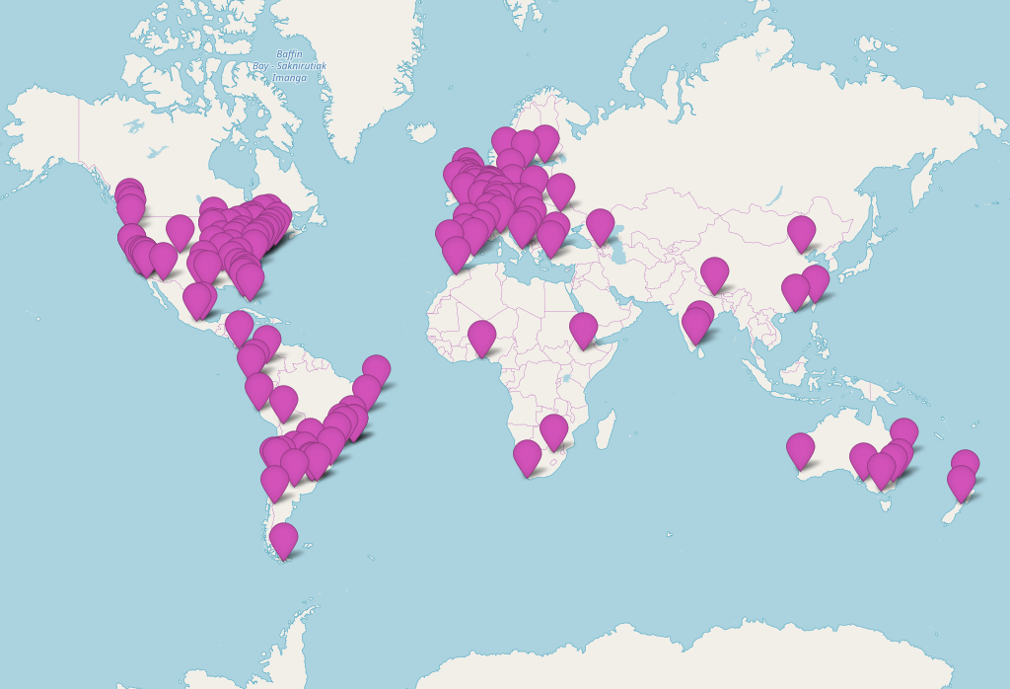
What is R-Ladies?
First meetup in San Francisco in 2012
Now 147 groups in 45 countries, > 43,000 members
Host regular events – anything from tutorials, lightning talk sessions, to social events
Slack group to share information too

Slide 4
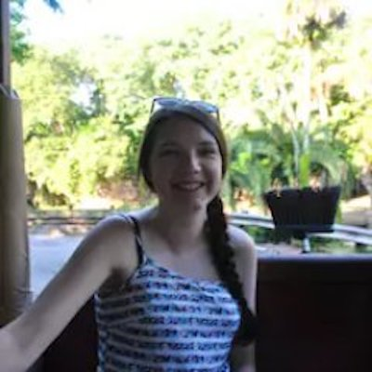
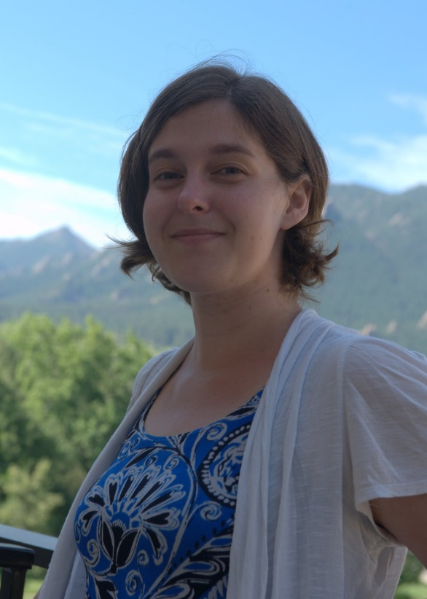
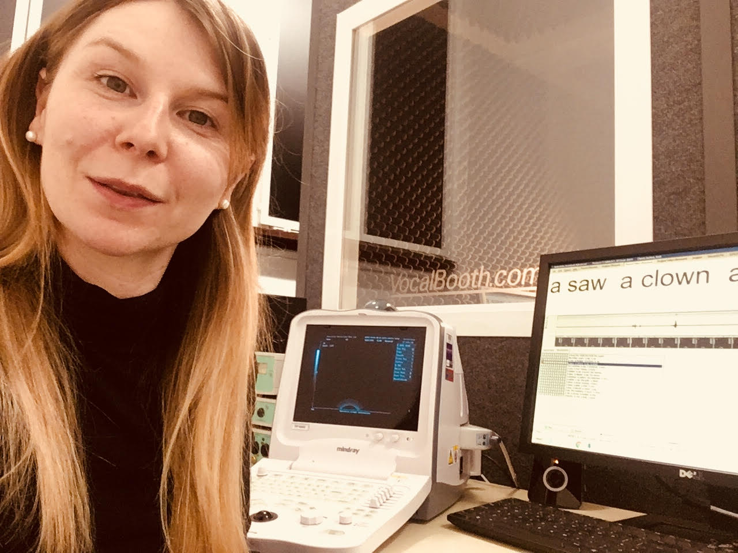
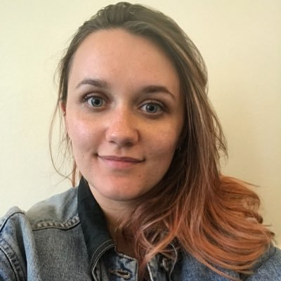
Who is organising R-Ladies Newcastle?

Slide 5
What are our goal and aims?
Our goal is to increase diversity of R-users in Newcastle, by providing both training as well as a community
Our meetings are open to women and gender minorities
To grow a supportive, inclusive community of R users of women and minority genders
To provide a networking space for women and minority genders
To provide training in R skills from basic to advanced levels

Slide 6
Upcoming meetups
We will meet every 1st Tuesday of each month
Our next meetup will be on the 2nd July
See our meetup page for more details: www.meetup.com/rladies-newcastle/
Give us a follow on twitter: @RLadiesNCL

